Slide 1
Purpose and Design of an Organizational Unit (OU) Structure
By Rosemarie Kpaka

Slide 2
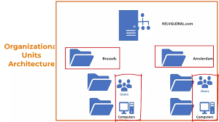
Introduction to Organizational Units (OU)
An Organizational Unit (OU) is a container within Active Directory that organizes resources (e.g., users, computers).
To simplify resource management, security, and policy application.

Slide 3
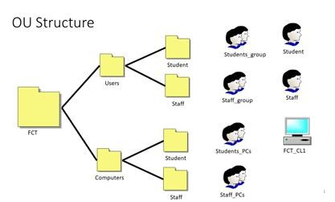
Key Benefits of Using Organizational Units
Enhanced Management: Provides a structured hierarchy for easy navigation.
Security and Compliance: Simplifies policy enforcement and compliance with data protection standards.
Delegation of Control: Allows permissions to be delegated to department-level administrators.

Slide 4
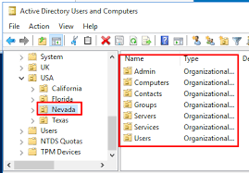
Functions of an OU in Active Directory
Centralized Resource Control: Enables configuration management from one central location.
Application of Group Policies: Applies security settings and configurations.
Streamlined User and Resource Management: Simplifies day-to-day management for IT support staff.

Slide 5
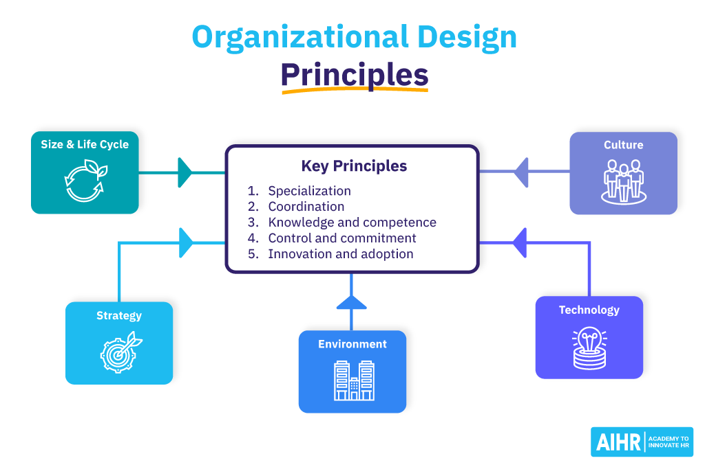
Design Goals for an Effective OU Structure
Scalability: Easily adaptable for future expansion or restructuring.
Security and Compliance: Adheres to security principles and compliance needs.
Simplicity: Ensures ease of management and navigation within the directory.

Slide 6
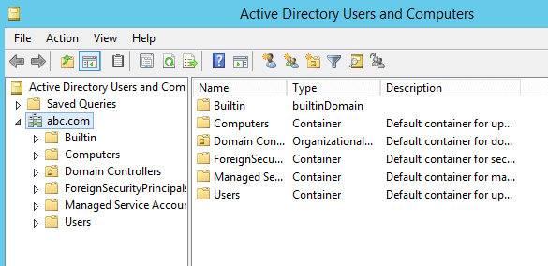
Proposed Top-Level OU Structure
Main OUs: Organized as Users, Computers, and Groups.
Purpose of Each Top-Level OU: Clarifies how each OU aids specific management and security goals.

Slide 7

Designing the User OU
Purpose: Organizes users based on departments (e.g., Sales, Marketing, IT).
Example Policies: Restricted access to certain resources; tailored Group Policies per department.
Benefits: Facilitates targeted permissions and streamlined access control.

Slide 8
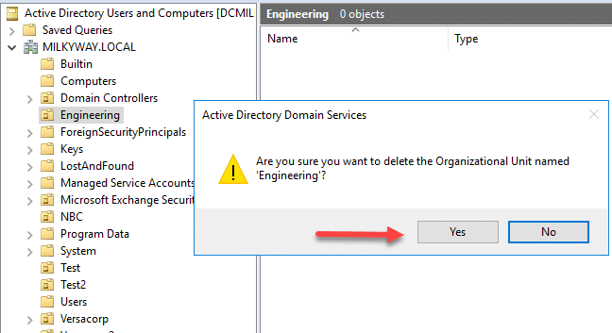
Designing the Computer OU
Purpose: Groups computers by department or operating system.
Example Policies: Applies OS-specific policies (e.g., Windows updates, antivirus settings).
Benefits: Enables efficient device management and security updates.

Slide 9
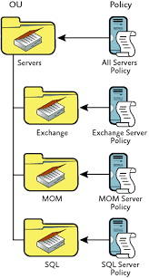
Designing the Group OU
Purpose: Organizes security and distribution groups for specific resource permissions.
Example Usage: Controls file access for security; email lists for departments.
Benefits: Simplifies permissions and communication management.

Slide 10
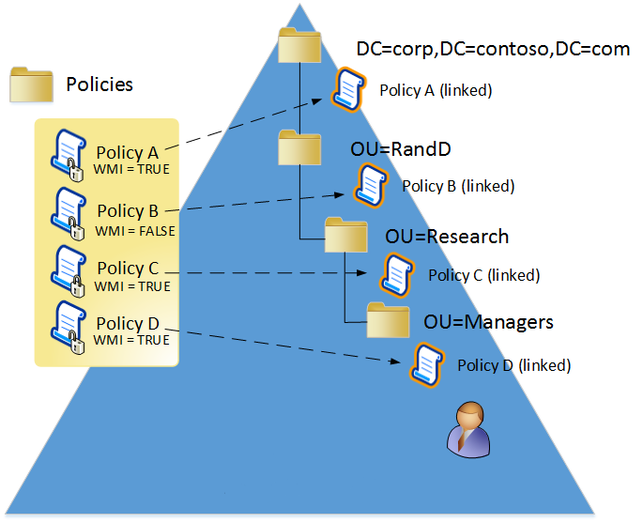
Understanding Group Policy in OU Design
Group Policy Overview: Policies can be applied to specific OUs for customized settings.
Example Policies: Password policies, access permissions, login scripts.
Impact: Policies enhance security and ensure compliance across all departments.

Slide 11
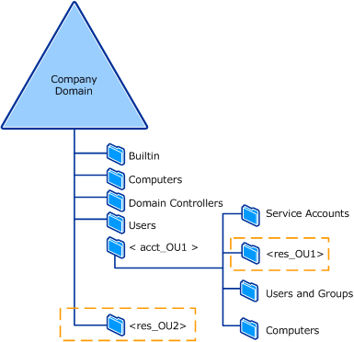
Delegation of Control with OUs
Purpose: Grants specific permissions within OUs, reducing IT workload.
Example: Department heads manage their own team’s resources, while IT retains oversight.
Benefits: Balances autonomy with central IT oversight.

Slide 12

Security Best Practices in OU Management
Principle of Least Privilege: Limits access to only what’s necessary for each role.
Regular Audits: Periodically reviews and updates permissions for compliance and security.

Slide 13
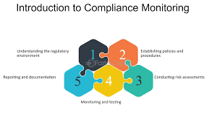
Compliance and Monitoring within OUs
Why Compliance Matters: Regulatory standards (GDPR, HIPAA) affect data handling.
OU Structure for Compliance: Makes monitoring and auditing permissions more efficient.

Slide 14
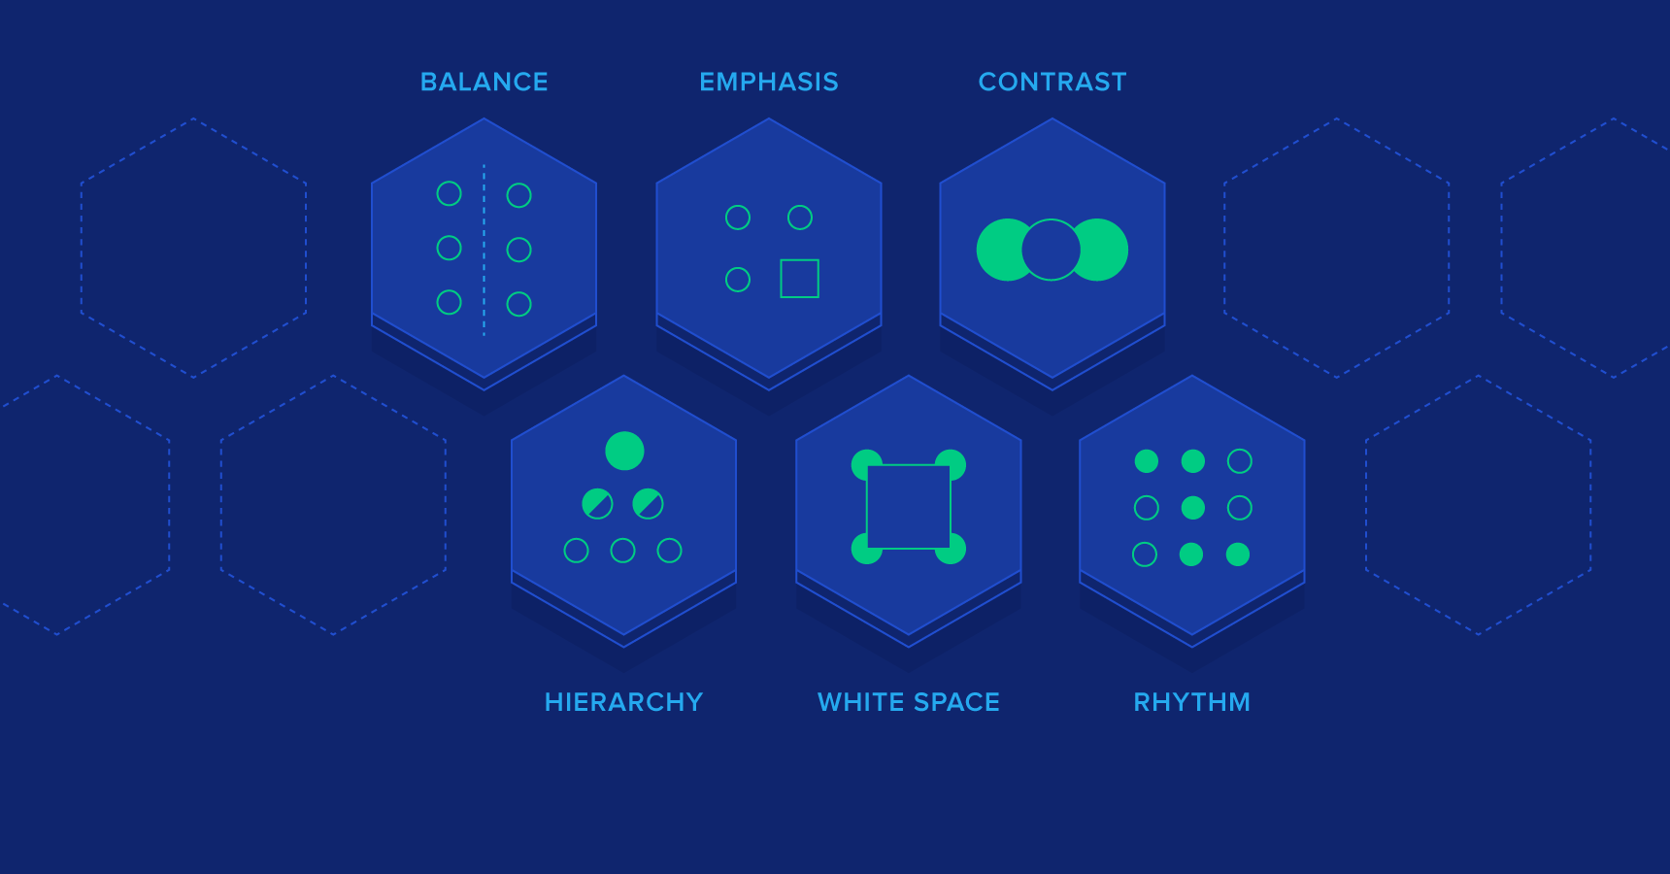
Summary of OU Design Principles
Recap: Centralized management, security, simplicity, and targeted control.
Design Principles in Action: How these principles help streamline operations.

Slide 15

Practical Benefits for IT Support Staff
Simplified Management: Clear organization aids troubleshooting and task efficiency.
Improved Response Time: OU structure allows IT support to respond quickly to departmental needs.

Slide 16
Thank You!
By Rosemarie Kpaka

